Slide 1
MidTerM pROpOSaL
Joseph Kang

Slide 2
Website: Portfolio
Minimal website
Will display recent works
Composed of
Home Page
About Me page
Projects page

Slide 3

Home Page
Background will be color-changing
“About Me” picture will be a subtle picture of myself
“Projects” picture will include a picture of one of my projects
Boxes will change shade upon hovering

Slide 4
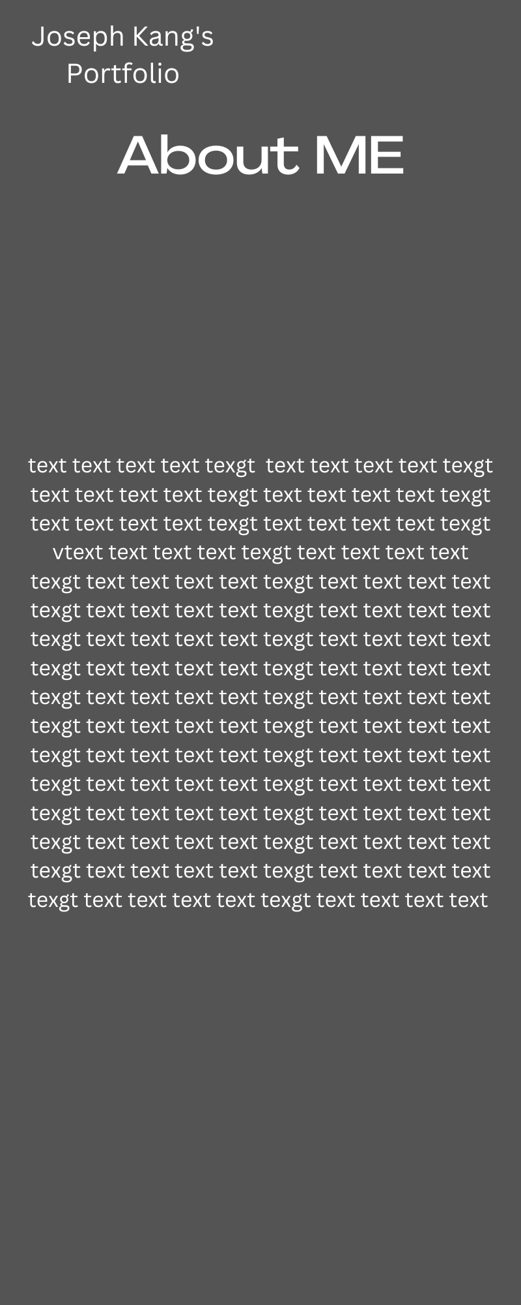
Section 1 : About Me
Picture of me
Picture of me
(probably candid)

Slide 5
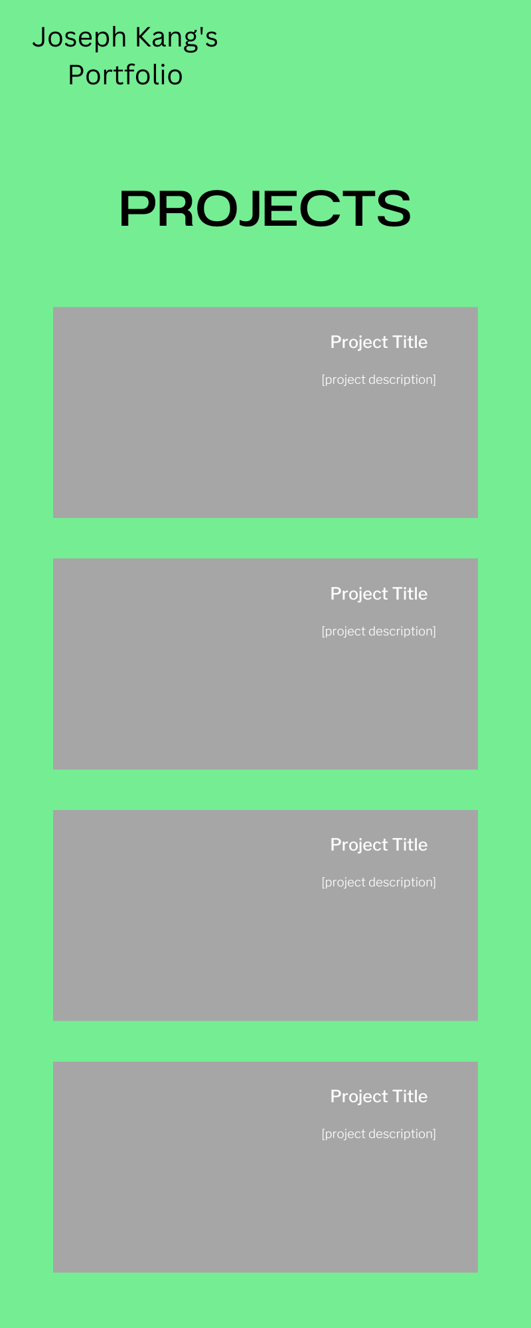
Section 2: Projects
Projects page will include various projects, ranging from cool p5.js creations to graphic designs

